Slide 1
A Project Review On
ROBUST FUSION OF MULTI-MODALITY MEDICAL IMAGES WITH FIDELITY-DRIVEN OPTIMIZATION AND DETAIL PRESERVATION

Slide 2
ROBUST FUSION OF MULTI-MODALITY MEDICAL IMAGES WITH FIDELITY-DRIVEN OPTIMIZATION AND DETAIL PRESERVATTION

Slide 3
OUTLINE OF PRESENTATION
Introduction
Objectives
Literature Survey
Methodology
Existing System
Proposed System
Software Required
Results
Conclusion
Future Enhancement
APPENDICES

Slide 4
INTRODUCTION:
Medical imaging is crucial in healthcare, offering vital information for diagnosis and treatment planning by providing insights into the human body. Multiple imaging modalities has grown due to technological advancements.
The combination of Details Preserving Guided Fusion and Fidelity-driven Optimization Reconstruction aims to enhance the quality of images by conserving crucial information and maximizing fidelity characteristics during the reconstruction process
Analyzing multi-modality medical imaging by combining functional and structural information enhances overall comprehension of patient conditions.
While functional imaging modalities like PET ,SPECT ,CT shows the intrinsic lower resolution can be addressed by combining them with MRI, providing more accurate anatomical and structural details for improved interpretation in medical diagnosis and treatment.

Slide 5
OBJECTIVES:
Fusion of multi-modality medical image with Fidelity Driven Optimization and detail preservation ,could be to develop a computational technique or algorithm that enhances the quality of multi-modal medical images while preserving important anatomical details. This may involve the following goals:
Improved Image Quality
Multi-Modal Fusion
Details Preservation
Clinical Applicability

Slide 6
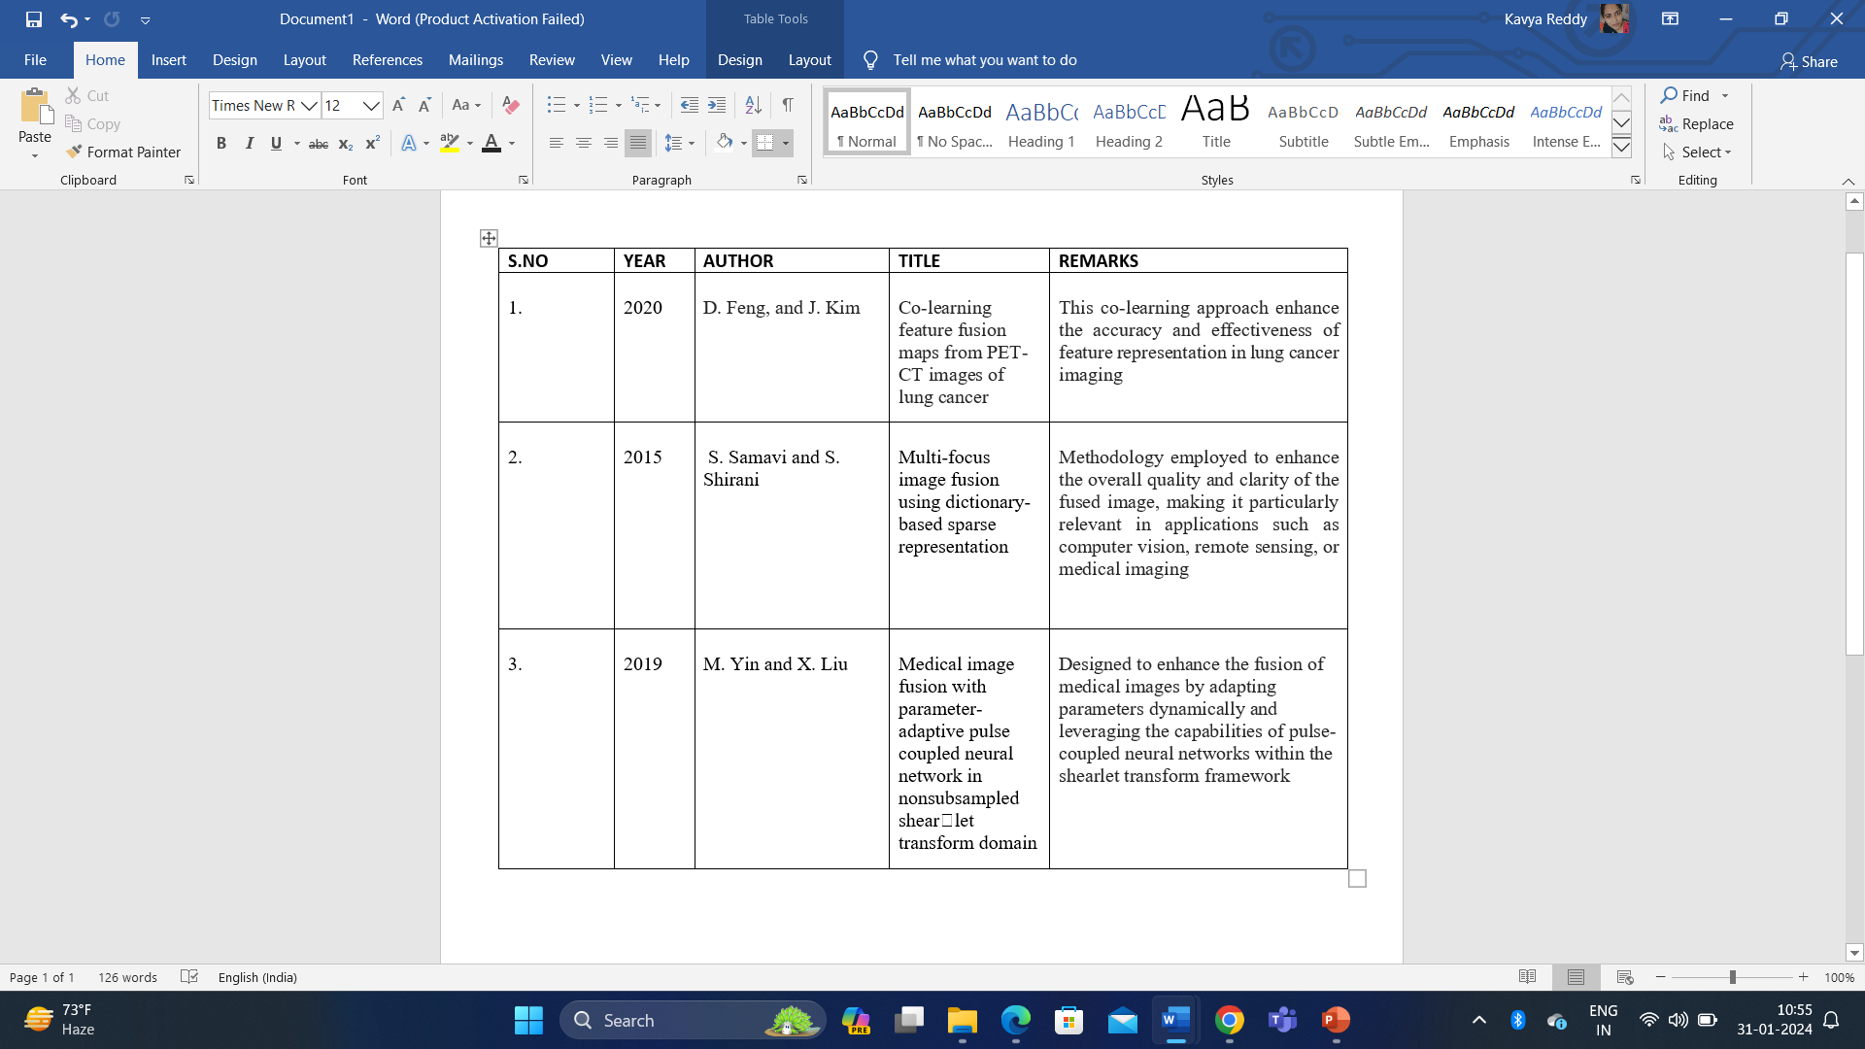
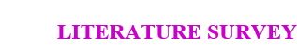

Slide 7
Methodology:
The methodology involves in two- step process:
Reconstruction using Fidelity-driven Optimization (FDO):
Goal: Improve the visual quality and minimize noise in the original photos.
Specifics for Maintaining Guided Fusion (DPGF):
Goal: Combine related data while maintaining textures and details.

Slide 8
Existing System:
Single Modality Medical Imaging fusion technique.
Modality Medical Imaging fusion with adaptive weighted combination.
Modality Medical Imaging fusion using clustered dictionary learning in non-subsampled shearlet transform.
LIMITATIONS:
More Noise
Low Quality

Slide 9
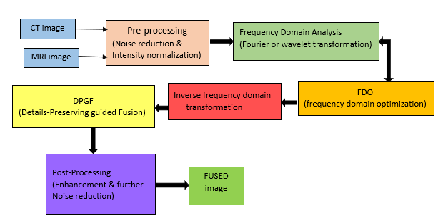
Proposed System:

Slide 10
1.Data Input:
Utilizes medical images from different modalities such as CT, MRI, or PET.
Accounts for potential issues like noise, artifacts, or flaws in the imaging process.
2.Pre-Processing:
Applies modality-specific pre-processing techniques to enhance features, normalize intensities, and correct artifacts.
Frequency Domain Analysis:
Converts the image into the frequency domain, often using wavelet or Fourier transforms.
Enables more effective analysis of the frequency components of the visual content.
Frequency Domain Optimization (FDO): Optimizes features within the frequency domain.
Involves manipulating or transforming collected features to enhance specific qualities such as contrast or clarity.
Utilizes techniques like filtering, normalization, or other feature-level procedures.

Slide 11
Transform the Inverse Frequency Domain:
Converts the image back from the frequency domain to the spatial domain.
Utilizes methods like the Fourier Transform and its inverse.
Details Preserving Guided Filter (DPGF):
Applies guided filters for tasks like edge-preserving filtering and smoothing.
Details Preserving Guided Filter (DPGF) specifically focuses on maintaining important details while improving or smoothing the image, which is particularly beneficial in medical imaging for preserving fine structures.
Post-processing:
Involves applying additional methods or algorithms to the image after the initial processing.
Common post-processing techniques in medical imaging include sharpening, contrast enhancement, and noise reduction to improve overall image quality.

Slide 12
FUSED Image:
In the context of Frequency Domain Optimization (FDO) reconstruction, the term "FUSED" likely refers to fused images or modalities.
Image fusion combines information from multiple sources or modalities to create a more comprehensive or informative image.
FDO may be applied during the reconstruction process, optimizing image data in the frequency domain to produce a refined and enhanced fused image.
This comprehensive process aims to improve the quality, accuracy, and interpretability of medical images for diagnostic and treatment planning purposes.

Slide 13
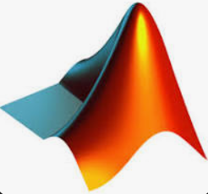
Software Required:
MATLAB TOOL
Common applications include:
• Math and computation
• Algorithm creation.
• Modeling, simulation, and prototyping.
• Data analysis, exploration, and visualization.
• Scientific and engineering graphic.
• Application growth, especially graphical user interface design

Slide 14
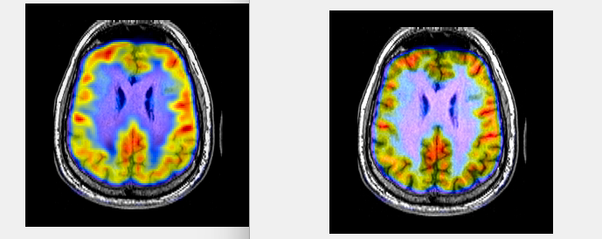
Results:
With the help of these two phases, the suggested fusion architecture performs superbly in detail integration and has high robustness. The comprehensive numerable and quality results reveal the suggested fusion outperforms certain cutting-edge techniques, indicating potential applications in medical diagnosis.
Fig: mri_090.jpg & pet_090.jpg

Slide 15
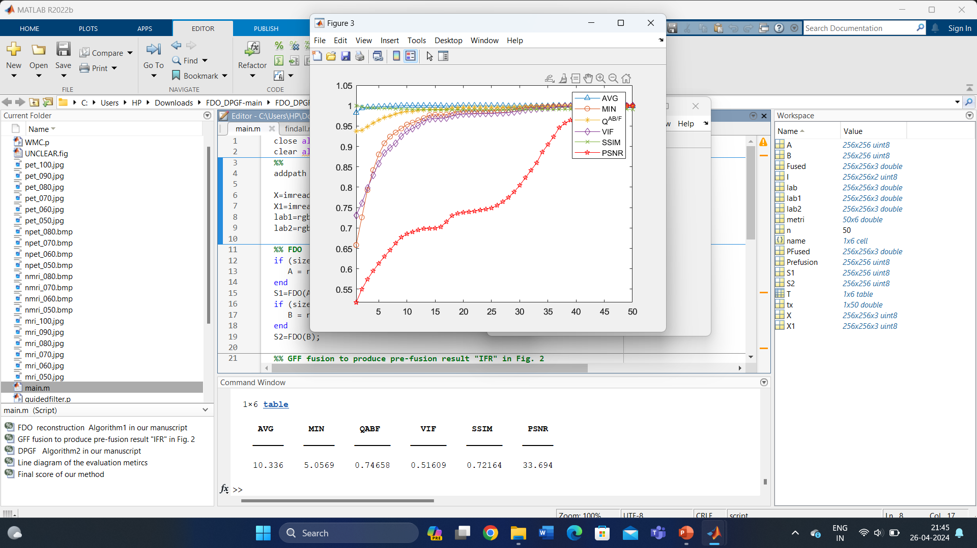
Characteristics: AVG MIN QABF VIF SSIM PSNR ______ ______ _______ _______ _______ ______ 10.336 5.0569 0.74658 0.51609 0.72164 33.694

Slide 16
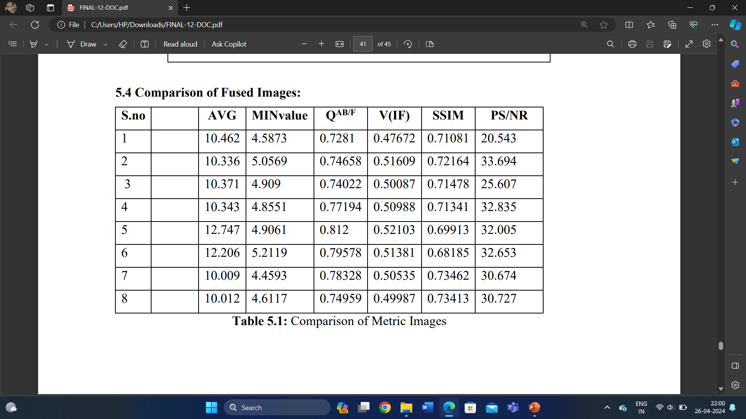
Output Comparison of different medical images:

Slide 17
Conclusion:
Finally, the suggested process for robust fusing of multimodality medical imaging, which incorporates fidelity driven optimization and detail preservation, provides a comprehensive strategy for effectively integrating information from CT and MRI. The methodology, which includes pretreatment, domain of frequency evaluation, optimizing, detailed preservation, and post-processing, ensures the development of fused pictures that maintain key diagnostic information while eliminating artifacts and redundancy. The suggested method uses methods like reduction of noise, guided fusion, and optimization to improve both the reliability and quality of fused pictures, allowing for better healthcare interpretation and decision-making. However, more validation and improvement are required to reach its full efficiency in clinical settings.

Slide 18
Future Scope:
Exploring strategies for quantifying uncertainty in fused pictures could boost diagnostic confidence and simplify clinical interpretation. Developing new fusion methods beyond those already in use may result in further improvements in fusing quality and efficiency.
Continuous study and improvement activities in these areas are critical to moving the suggested approach forward and achieving its potential for better medical picture fusion and interpretation.

Slide 19
APPENDICES:
LIST OF PUBLICATIONS:
M.Ravi Kishore, N.Kavya, G.LakshmiNaveena, J.Jahnavi, G.Kalyan, B.Jaya Chandra,
A Paper tittled “ROBUST FUSION OF MULTIMODALITMEDICAL IMAGES WITH FIDELITY DRIVEN OPTIMIZATION AND DETAIL -PRESERVATION”, Accepted for International Conference of Communication and Cyber physical Engineering(ICCCE), 2024 at G.Narayanamma Institute of Technology & Sciences.

Slide 20


